Slide 1

Department of Electronics and Communication Engineering
MINOR PROJECT – 2
Ethereum Token Request and Comment 20
SL.NO. | NAME | USN | ROLL NO.
01 | Bhakti Betageri | 02FE21BEC019 | 16
02 | Bhuvan Budavi | 02FE21BEC021 | 18
03 | Komal Melavanki | 02FE21BEC042 | 38
04 | Praveen Magadum | 02FE21BEC064 | 59
Under the Guidance of
Prof . Shweta K
Department of Electronics and Communication Engineering,
KLE Technological University’s Dr. MSSCET , Belagavi Campus

Slide 2
Problem Statement
Design and Implementation of an ERC20 Token on the Ethereum Blockchain.
Dept. of ECE

Slide 3
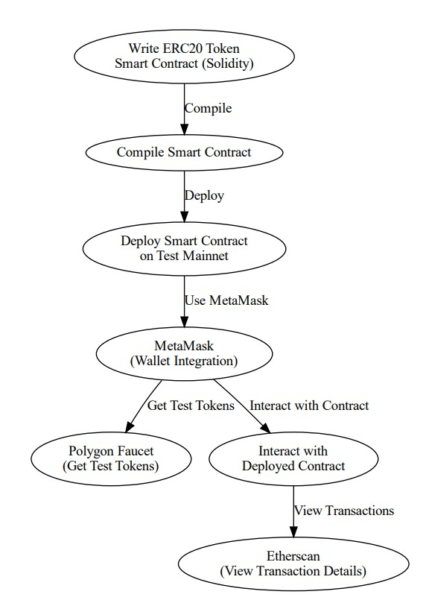
Design Methodology
Dept. of ECE

Slide 4
Concepts Applied
ERC 20 Token Generation
Blockchain Technology
Solidity Programming
Remix IDE
MetaMask Wallet
Dept. of ECE

Slide 5
Concept of Optimization
Gas Efficiency: Implement efficient code practices to minimize gas consumption, such as using the latest Solidity compiler version, optimizing storage usage, and avoiding unnecessary state changes.
Contract Size Reduction: Keep the contract size under the Ethereum block gas limit by removing redundant code and using libraries for common functions.
Security Enhancements: Conduct thorough security audits and implement best practices like using OpenZeppelin’s audited libraries, avoiding untrusted external calls, and ensuring safe arithmetic operations with SafeMath.
Testing and Debugging: Employ extensive unit and integration tests to identify and fix issues early. Use tools like Truffle, Hardhat, and Remix for automated and manual testing.
Deployment Strategy: Deploy the contract to a testnet before the mainnet to ensure it functions correctly. Use a multi-signature wallet for deployment to enhance security.
Dept. of ECE

Slide 6
Applications
Cryptocurrency Creation: Launch new digital currencies for various purposes.
Crowdfunding and Initial Coin Offerings (ICOs): Raise funds for projects by issuing tokens.
Decentralized Finance (DeFi): Facilitate lending, borrowing, and staking in DeFi platforms.
Governance Tokens: Enable decentralized governance in blockchain projects.
Utility Tokens: Provide access to services and products within a specific ecosystem.
Dept. of ECE

Slide 7
Goals of SDG
SDG 12, 14, 15: Responsible Production and Consumption
Blockchain has the huge potential to support the Circular Economy by ensuring good provenance throughout supply chains, enabling responsible production and consumption, life below the ocean and life on land. For instance, blockchain startup Provenance already tracks yellowfin and skipjack tuna from catch to customer while digitally strengthening the value of Soil Association Organic certification.
Dept. of ECE

Slide 8
Thank you
Dept. of ECE

